Slide 1
Kidney-Genetics: a curated list of kidney-disease associated genes enables standardized diagnostics and development of an automated Nephro Candidate Score (NCS)
CADS-Meeting 2023-07-13, Bernt Popp

Slide 2
Disease genes
How many disease genes are there for a disease group?
Which genes are relevant for diagnostics?
How can we systematically identify new genes (candidates)?

Slide 3
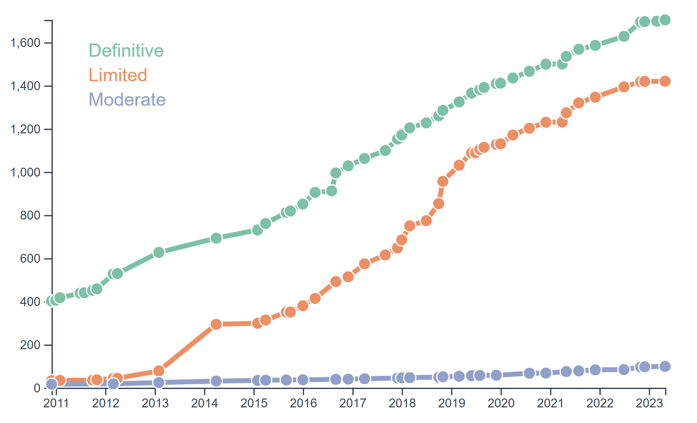
Disease genes – Example neurodevelopmental disorders (NDD)
clinically and genetically extremely heterogeneous (DD, ID, ASD)
How to keep track?
SysNDD, www.sysndd.org; Popp et al. manuscript in preparation

Slide 4
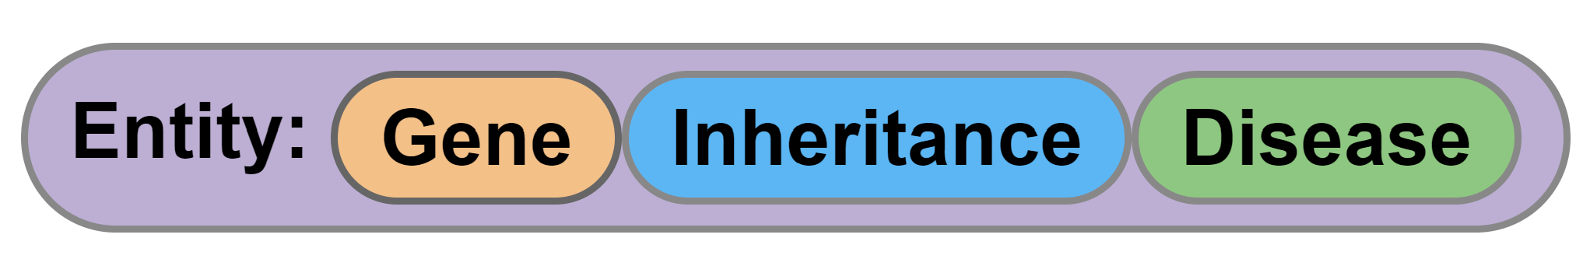




Disease genes – Curation concept and databases
PKD1 – autosomal dominant - Polycystic kidney disease 1 (OMIM:173900)
PKD1 – autosomal recessive – cystic kidney disease (MONDO:0002473)
SysNDD, www.sysndd.org; Popp et al. manuscript in preparation
Notes:
TODO: add example for trias

Slide 5
Chronic Kidney Disease (CKD)
Complications: cardiovascular events ↑, infections ↑, malignancies ↑, …
Prevalence: 10% ↑
CKD as cause of death ↑
ENVIRONMENT
GENETICS
POLYGENIC
MONOGENIC
> 10 %
Frequent causes
Hypertension
Diabetes mellitus
Rare causes
Congenital kidney anomalies
Polycystic kidney disease
…

Slide 6
CKD – Genetic diagnostics
Congenital Kidney Disorders
Polycystic Kidney Disease
20% solved
90% solved
?
?
80% unsolved
10% unsolved
Problems:
high genetic heterogeneity (~600 genes according to literature)
gene lists often not standardized between labs
small diagnostic panels vs. large screening lists
weakly associated genes (GUS) and multiple inheritance patterns

Slide 7
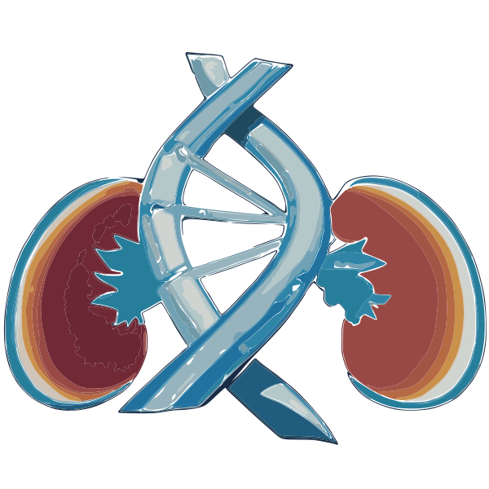
Kidney-Genetics – Aims and Concept
design a reproducible, automatically updatable,
curated and publicly available list of all relevant kidney associated genes
CURATED GENE LIST
PubTator query
PanelApp request
Literature review
Commercial panels
HPO terms in OMIM
Automated Pipeline

Slide 8
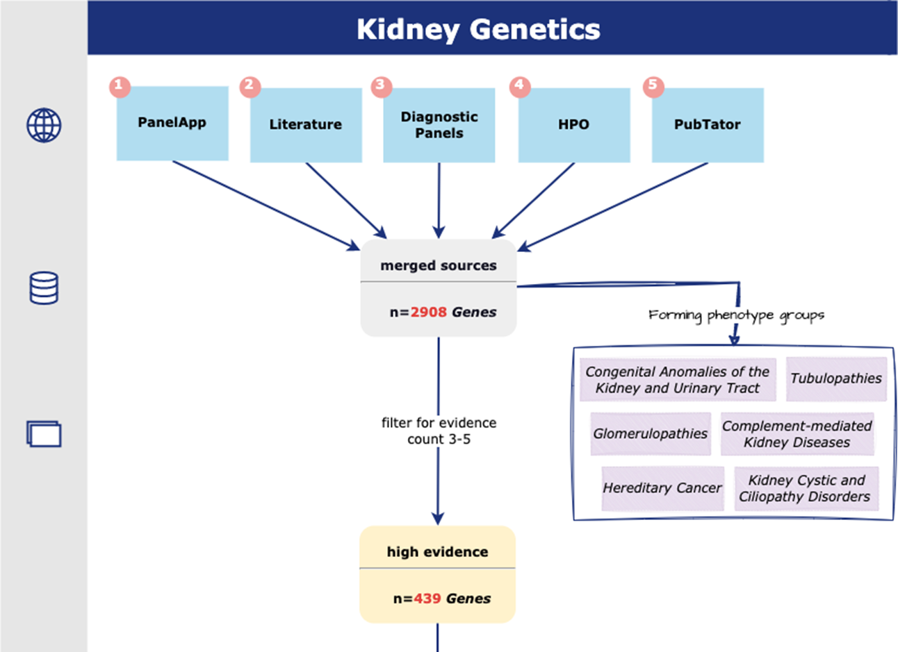
Kidney-Genetics - Flowchart
+ onset & syndromicity groups

Slide 9
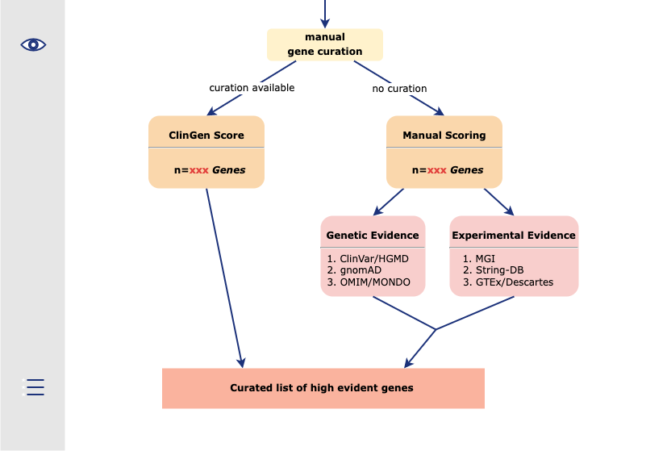
Kidney-Genetics - Flowchart

Slide 10
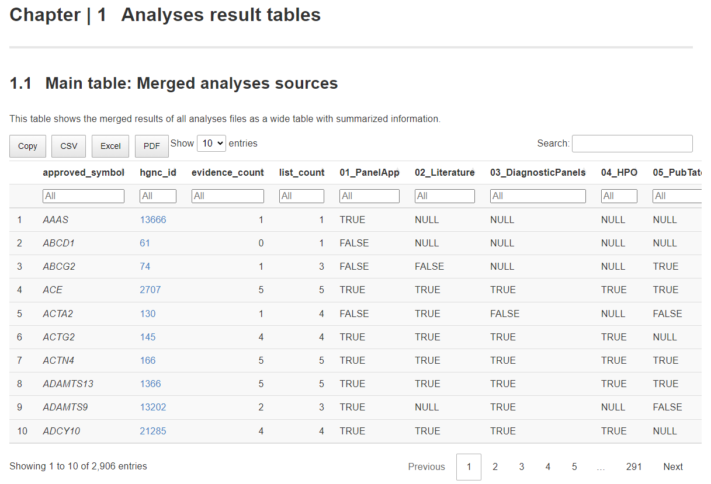
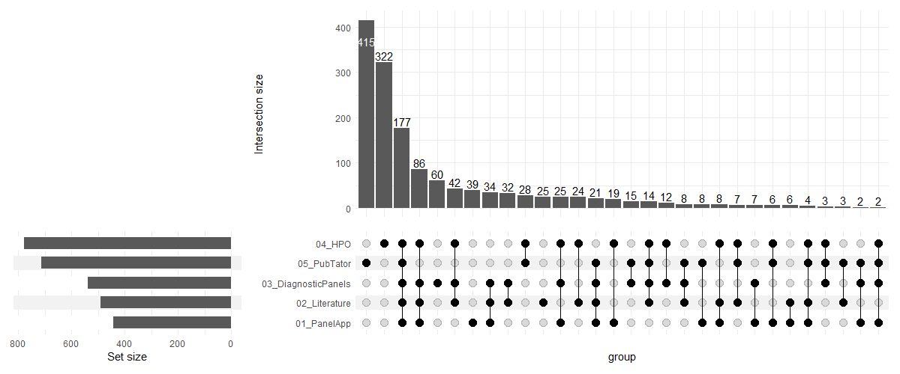
Kidney-Genetics - Current status
Code on GitHub:
https://github.com/halbritter-lab/kidney-genetics
Website and documentation (GitHub Pages):
https://kidney-genetics.org

Slide 11
Kidney-Genetics – Summary and next steps
automated and reproducible
currently only database for kidney disease genes
completely open and free
→ application in diagnostics and research
manually curate entities for high confidence genes
design a curation support system and implement re-curation workflow
citeable release freezes
webtool and API (v2)

Slide 12
CKD – Solving the unsolved
Congenital Kidney Disorders
Polycystic Kidney Disease
20% solved
90% solved
?
?
80% unsolved
10% unsolved
Goal: identification of novel kidney disease genes
Problems:
large number of candidate variants from NGS
limited resources for evaluation

Slide 13

Nephro Candidate Score (NCS)
Assumption:
Disease genes share common characteristics
Use these to predict new disease genes
(Leitão et al., 2022)
Variant
Gene
NCS = Score + Score
Allele frequency
RNAseq data
+
Impact on protein
Animal model
+
Inheritance
Conservation
Positive Genes
=> “Kidney-Genetics”
+
…
…
Negative Genes
= “Dispensable” Genes
time-consuming
evaluator dependent
expert knowledge needed
Predictors
Labels
Simple scoring heuristic *
Machine Learning:
80% Training Set, 20% Test Set
Goal: standardized, automatic evaluation tool for candidate variant prioritization
* Lieberwirth et al. Hum Mutat. 2023; https://autocasc.uni-leipzig.de

Slide 14
Web Tool Command Line Tool
webNCS About FAQ Impressum
Enter your variant here:
vcfNCS
userPC:~ user$ vcfNCS myfile.vcf family.ped
retrieving data…
processing…
Chrom | Pos | Ref | Alt | VS | GS | NCS
chrX | 12345005 | T | C | 1 | 1.9 | 2.9
chr9 | 23434512 | A | C | 5 | 5.2 | 10.2
chr11 | 4637222 | C | G | 2 | 1.4 | 3.4
… … …
12:121987483:A:C
11.2
Variant: 12:121987483:A:C NCS:
Gene: KDM2B
Variant Score: Gene score:
Inheritance 2
Allele frequency 2
Impact on protein 3
_____________________________________
?
7
4.2
adapted from Lieberwirth et al. Hum Mutat. 2023; https://autocasc.uni-leipzig.de

Slide 15



NCS - Validation
Diagnostic cohort
currently 102 exomes
77% no variant reported
different kidney diseases
German Chronic Kidney Disease Study
5,000 exomes
CKD
UK Biobank
470,000 exomes
CKD/no CKD
select highest scoring genes
GeneMatcher to find further cases

Slide 16
NCS - Summary and next steps
automated => time-saving
machine learning => human bias ↓, underlying pattern detection
standardized => comparability ↑ => cooperation ↑
code on GitHub (not yet public)
currently: working on feature selection and annotation
training and validating the models
designing and programming the webtool
GENETICS

Slide 17

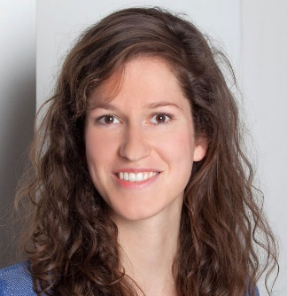

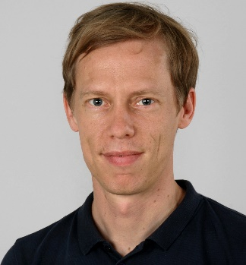
Questions and suggestions?
Constantin Wolff
Kidney-Genetics
Funded NCS Project: Junior Digital Clinician Scientist
Dr. Nina Rank
NCS
Dr. Sören Lukassen
BIH Medical Omics
Prof. Jan Halbritter
Head of CeRKiD

